Slide 1
“
BIG DATA
“ 조장 : 김 은 민 ”
조원: 강승웅, 김동현, 최서윤

Slide 2

INDEX
01 / 문제 정의
02 / 프로젝트 과정
03 / 사용 데이터
04 / Modeling

Slide 3

문제제기
저출산 뉴스 붙이기(비즈니스 여성)
82년생 김지영 내용(사회문제 제기)

Slide 4
프로젝트 과정
데이터 수집 및 저장
데이터 가공
머신러닝 활용 모델 완성
GIS 분석을 통한 최적지 선정

Slide 5

사용데이터
인구데이터
공동육아 나눔터(시설)
맞벌이 부부데이터
출생아수
직업별 신혼부부수
표준지 공시지가

Slide 6

Modeling
“
K-means clustering
시설 및 이용자 접근성 분석의 독립변수를 추출하기 위해 위탁센터 위도 및 경도 데이터를 학습하여 위탁센서 그룹의 중심점과 위탁센터의 거리를 구하고자 함
GIS 공간 분석
머신러닝 모델을 통해 소외된 행정동을 파악하고 위탁센터 최적지 추천
회귀분석
2018년까지의 영유아 인구 데이터를 학습하여 2020년 행정동별 영유아 인구를 예측

Slide 7
“
DESIGN
Thought dissolves with sensitivity to design.
We will put your dreams into your presentations.
01
02
03
YPTLAB
YPTLAB
YPTLAB
DESIGN
DESIGN
DESIGN

Slide 8
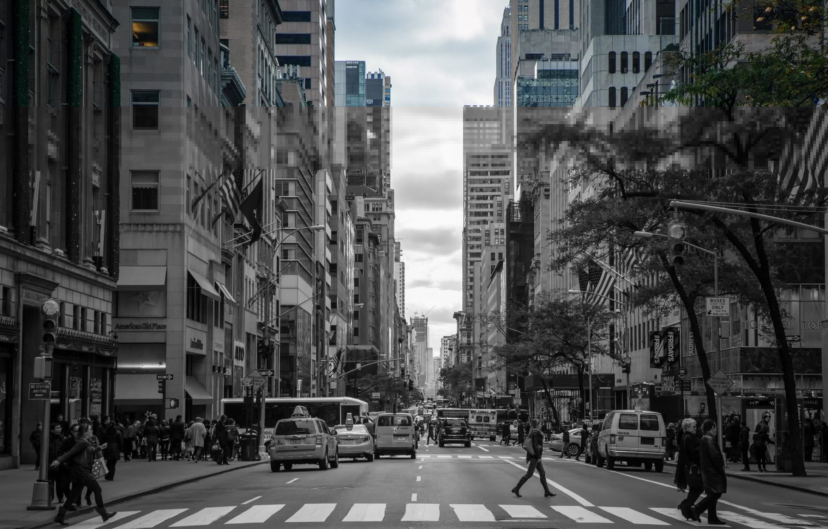


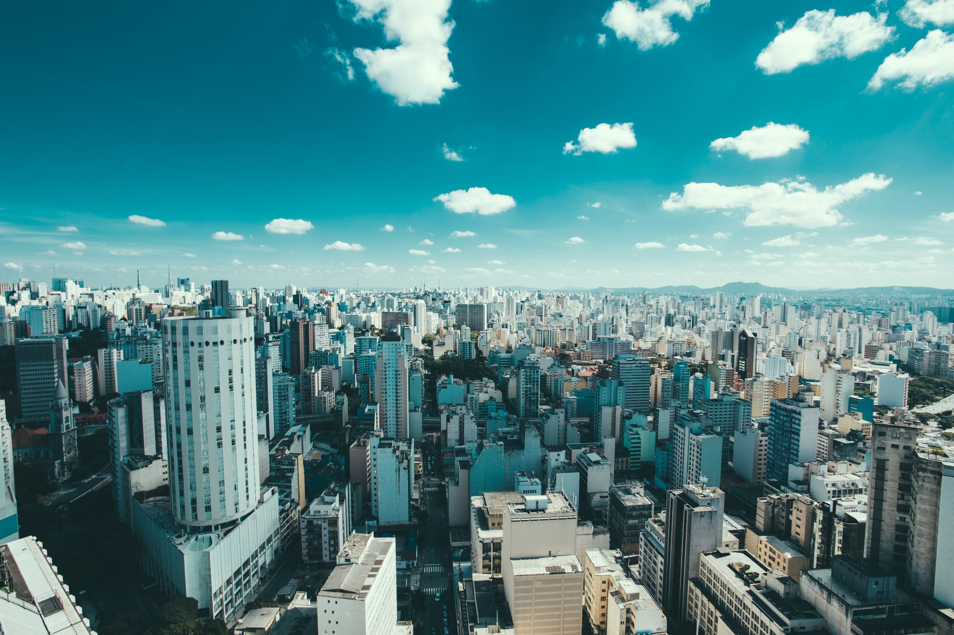
YPTLAB DESIGN
Thought dissolves
with sensitivity to design.
We will put your dreams into
your presentations.
Thought dissolves
with sensitivity to design.
We will put your dreams into
your presentations.
Thought dissolves
with sensitivity to design.
We will put your dreams into
your presentations.
Thought dissolves
with sensitivity to design.
We will put your dreams into
your presentations.

Slide 9




“
A :
n%
E :
n%
YPTLAB
POWERPOINT
B :
n%
F :
n%
DESIGN
C :
n%
G :
n%
D :
n%
H :
n%
- sensitivity to design.
- sensitivity to design.
- sensitivity to design.
- sensitivity to design.
- sensitivity to design.
- sensitivity to design.
- sensitivity to design.
- sensitivity to design.
- sensitivity to design.
- sensitivity to design.
- sensitivity to design.
- sensitivity to design.
- sensitivity to design.
- sensitivity to design.
- sensitivity to design.
- sensitivity to design.
Click
Click
Click
Click

Slide 10
“
DESIGN
Thought dissolves with sensitivity to design.
We will put your dreams into your presentations.
DESIGN A
DESIGN B
DESIGN C
Thought dissolves with sensitivity to design. We will put your dreams into your presentations.
Thought dissolves with sensitivity to design. We will put your dreams into your presentations.
Thought dissolves with sensitivity to design. We will put your dreams into your presentations.
Thought dissolves with sensitivity to design. We will put your dreams into your presentations.
Thought dissolves with sensitivity to design. We will put your dreams into your presentations.
Thought dissolves with sensitivity to design. We will put your dreams into your presentations.

Slide 11
“
YPTLAB
POWERPOINT
THX U

